Slide 1
An Introduction to R

Slide 2
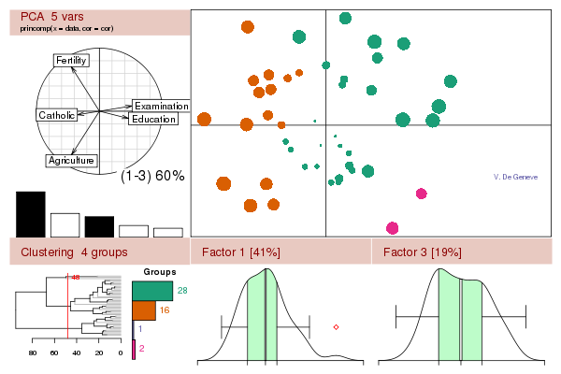

R
Programming language and software environment for statistical computations
High number of “packages”
Implement many common statistical procedures
Provide excellent graphics functionality
A convenient starting point for many data analysis projects
www.r-project.org

Slide 3
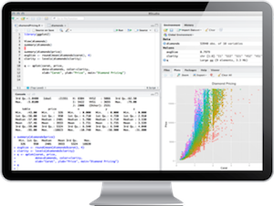

R Studio
Powerful IDE (integrated development environment) for R
Free and open source desktop version available
Syntax highlighting
Easy package installing
Overview of variables, plots etc.
This is not an R-Studio course
http://www.rstudio.com/

Slide 4
Tipps and Tricks
Always use an extra source file for your code
Export your results in extra files (especially when working with large datasets)
Reuse results
Help yourself with the integrated help, forums and tutorials
Don’t (just) copy and paste. Try to understand the code.
Don´t get frustrated!

Slide 5
R Introduction
Topic | Code | Description
Simple Calculations | > 2+3 [1] 5 >7-3 >3*5 >4^2 >7/3; 2^6 >2*(5+3) >2*5+3 | “>….” is a command line, “[1]5” is the output
 | # a comment | Code lines with a # at the beginning are not executed. They are comments.
Variables | > a=2+3 > a [1] 5 >pi >b=pi*3 >a+b >c=a+b | Assign 2+3 to “a” You may use a “<-” instead of a “=“
 | >ls() >rm(list=ls()) | List all your variables Remove all your variables

Slide 6
TASK
Calculate 3*5/(4 + 8) -9
Assign the variable name “result” to it
Multiply the result with 20

Slide 7
R Introduction
Topic | Code | Description
Comparisons | 3==3 4==5 3!= 4 4!= 4 3 <= 5 5 >= 2*2 | Returns a Boolean value (TRUE/FALSE) “==“ asks if both sides are equal “=!” askes if both sides are not eqal; ! Is a negation
Vectors | > b=c(2,3,4) > b [1] 2 3 4 | Create a vector with the function “c” that combines arguments into a vector or a list
Functions | > c=sum(b) > c [1] 9 | Functions have been implemented to make your life easier e.g. to sum the values of a vector
 | >d=c(1,4,4,3,2) >length(d) >rev(d) >sort(d) >unique(d) | Useful commands for vectors
 | > sum function (..., na.rm = FALSE) .Primitive("sum") | Type in only the function name to see the “head” of the function

Slide 8
Task
Create a vector with the length of 10 and the numbers 2,4,6,8,10,12,14,16,18,20
Calculate the sum of all values within the vector

Slide 9
R Introduction
Topic | Code | Description
Download, install and load packages into R | >install.packages(“raster”) > library (raster) | Functions are combined in so-called “packages” “library“ and “require” can both be used to load the package
Working directory | > setwd("C:/Users/….") > getwd() [1] "C:/Users/….“ >list.files() | Get and set the working directory The working directory is the Default location for import and export List the files of your working directory
Get Help | >?sum >help(sum) >??sum | Use “??” if you have not loaded the package with the function. In some GUIs it is also possible to get help in the console by hitting TAB (in R-Studio)

Slide 10
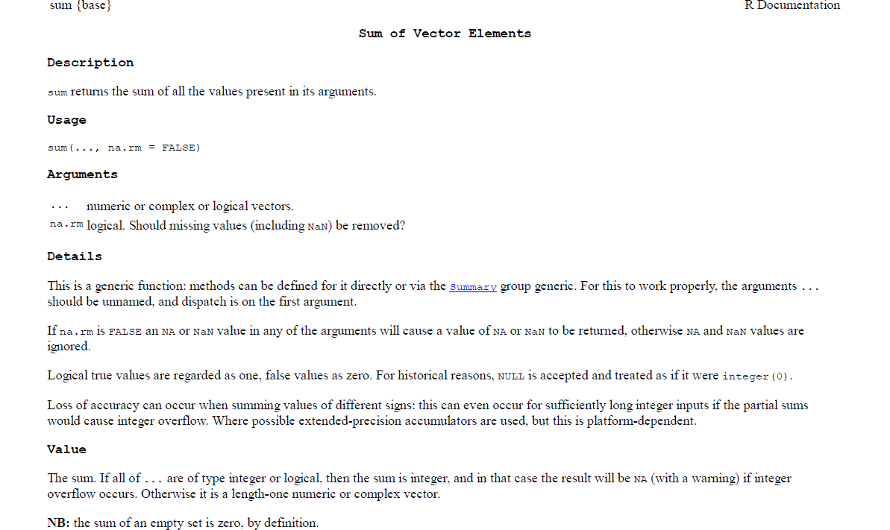
How does the help of R look like?
Function{Package}
Function(Arguments)
Output

Slide 11
R Introduction
Topic | Code | Description
Vectors - Creation | > v1 = c(1,2,3,4,5) > v1 [1] 1 2 3 4 5 | Create a vector with “c”
Vectors - Indexing | > v1[2] [1] 2 > v1[2]=4 > v1 [1] 1 4 3 4 5 >v1[-3] | Call the second value of the vector with [2] Replace the second value Exclude the third element
Vectors – Automated Creation | > v2=seq(from=1 , to=2, length=5) > v2 [1] 1.00 1.25 1.50 1.75 2.00 | Create a vector with 5 values ranging between 1 and 2 (equal steps)
Vectors - Operations | > v3=v1+v2 > v3 [1] 2.00 5.25 4.50 5.75 7.00 | Sum the values of vector 1 and vector 2
 | >x<-c(12,15,13,17,11) >x[x>12] <­ 0 >x[x==0] <­ 2 >x==2 | Some tricky but very useful commands on vectors

Slide 12
R Task 2
Create a vector with the length 50 and numbers between 0 and 5
Create a second vector with the length 50 and numbers between 100 and 150
Subtract the first vector from the second vector.
What is the 23rd value of the resulting vector?

Slide 13
R Introduction
Topic | Code | Description
Matrix - Creation | >v4=c(1,2,3,4,5,6,7,8,9,10) >mat1=matrix(data=v4,ncol=2) >mat1 [,1] [,2] [1,] 1 6 [2,] 2 7 [3,] 3 8 [4,] 4 9 [5,] 5 10 | Matrices are vectors with dimensions Define the vector first and then the matrix by giving the number of columns or rows OR
 | >mat2=matrix(data=c(1,2,3,4,5,6,7,8,9,10),nrow=2) > mat2 [,1] [,2] [,3] [,4] [,5] [1,] 1 3 5 7 9 [2,] 2 4 6 8 10 | Define the vector in the same line as defining the matrix
Matrix - Indexing | > mat2[1,2] [1] 3 > mat2[,2] [1] 3 4 > mat2[1,] [1] 1 3 5 7 9 | Call the values by giving first the number of the row and then the number of the column Return lines and columns by leaving the other field empty.

Slide 14
Task
Create one matrix with 2 columns and 10 rows with the values reaching from 1 to 10 in the first column and 11 to 20 in the second column
Multiply the value of the first row and second column with the value of the first column and 2nd row.
What is the result?

Slide 15
R Introduction
Topic | Code | Description
Data Frames - Creation | df=data.frame(A=c("one","two","three"),B=c(4,5,6),C=c(7,8,9),ID=c("Germany","Australia","Uruguay")) | Data frames are similar to matrices data types can be different e.g. numbers and strings With row.names=c(…) you can also add row names
Data Frames- Indexing | > df[,2] [1] 4 5 6 > df$B [1] 4 5 6 | Indexing can be done by numbers or names
Attributes | >attributes(df) | “attributes” returns a list of attributes and is helpful to understand how objects are structured

Slide 16
Task
Create a Dataframe with 3 columns and 4 rows. The names of the columns should be X,Y and Z and contain the values 4,5,6,7 in the first, 8,9,10,11 in the second and 12,13,14, and 15 in the third column. The row names should be “yes“, “no“, “maybe“, “don´t care“.

Slide 17
R Introduction
Topic | Code | Description
Merge two dataframes | df2=data.frame(E=c(12,13,14), F=c(“blue”,”red”,”green”), G=c(“a”,”b”,”c”)) cbind(df,df2) rbind(df,df2) | cbind merges two dataframes by columns; rbind merges two dataframes by rows
 | df3=data.frame(E=c(23,204,206),ID=c("Australia","Uruguay“,”Germany”)) merge(df,df3,by=“ID”) | Merge two dataframes by a unique identifier e.g. a country code

Slide 18
R Introduction
Topic | Code | Description
NA, NaN, Inf | y<-c(1,5,6,NA,3) y[1]<-NA is.na(y) sum(y,na.rm=TRUE) | is.na asks whether the condition is true na.rm is an argument removing na values and used in many functions
Descriptive statistics | mean(y) var(y) sd(y) median(y) quantile(y) Summary(y) | Mean value Variance Standard Deviation Median Quantiles Different stats

Slide 19
Task
Have a look at the dataset “cars”. Calculate the mean, median and quantiles of the speed of all cars

Slide 20
R Introduction
Topic | Code | Description
Import Data | setwd(“C:/Users/…”) list.files() read.table(“filename.txt”, header=TRUE) read.csv(“filename.csv”, header=TRUE) | Set your workspace to find your data Import your data from a text or a csv file. Many many other options exist!
Export Data | write.table(mydata, "c:/mydata.txt", sep="\t") write.csv(mydata) | Safe results as a tab-delimited text file or as a .csv file in you workspace. Many other options exist!

Slide 21
R Introduction
Topic | Code | Description
Correlations | cor(cars) cor(cars,method=“spearman”) | Calculate Pearson correlation Calculate other e.g. spearman correlation coefficient
Significance | install.packages(“Hmisc”) library(Hmisc) rcorr(cars$speed,cars$dist) rcorr(as.matrix(mtcars)) | Use rcorr to calculate also p-values You can also do this for a whole dataframe (convert lists to dataframe if necessary)

Slide 22
Visualization in R

Slide 23
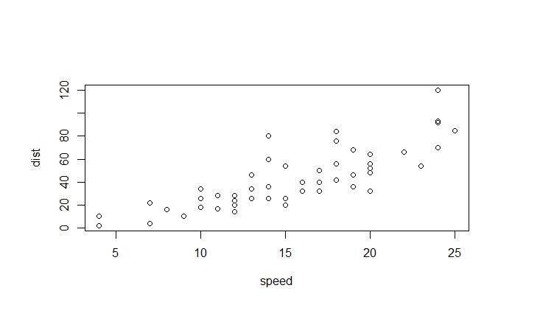
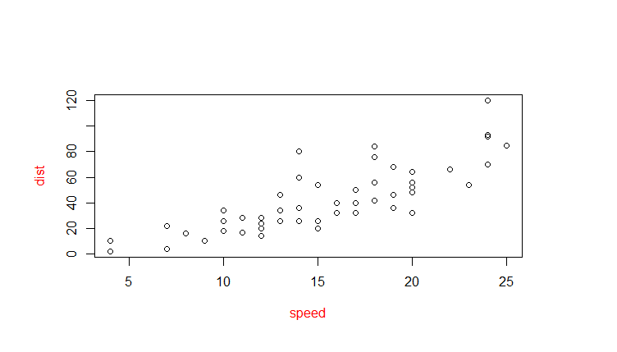
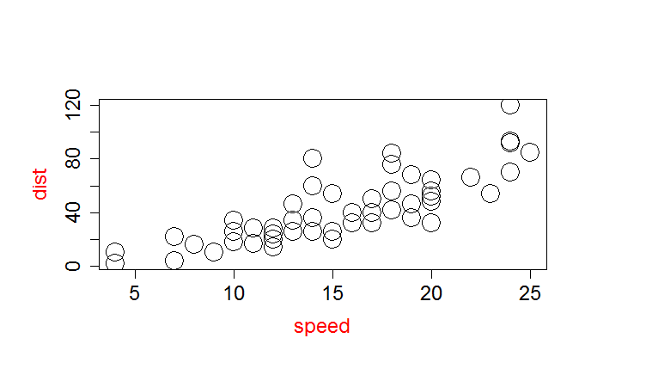
Setting Parameters
In R | Explanation
plot(cars) | Make a simple plot with default settings
plot(cars, col.lab="red") | set options within plotting function or
par() | Returns the current settings
opar<-par() par(col.lab="red") plot(cars) par<-(opar) | set graphical parameters with par but do not forget to safe your original settings
Sizing of symbols and text
plot(cars,col.lab="red",cex=3, cex.axis=1.5,cex.lab=1.5) | “cex” indicates the amount by which plotting text and symbols should be scaled relative to the default. 1=default, 1.5 is 50% larger, 0.5 is 50% smaller, etc. “cex.axis” magnification of axis annotation “cex.lab” magnification of x and y labels “cex.main” magnification of titles relative “cex.sub” magnification of subtitles

Slide 24
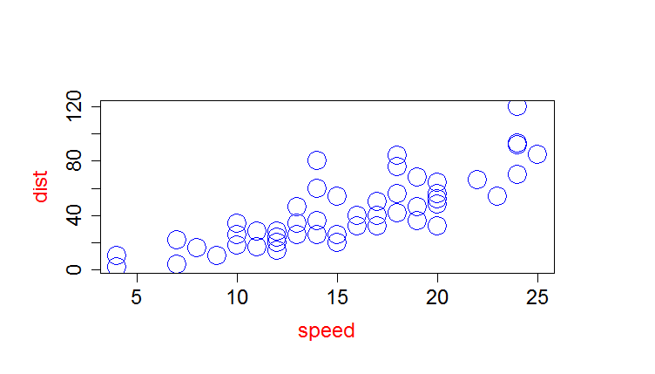
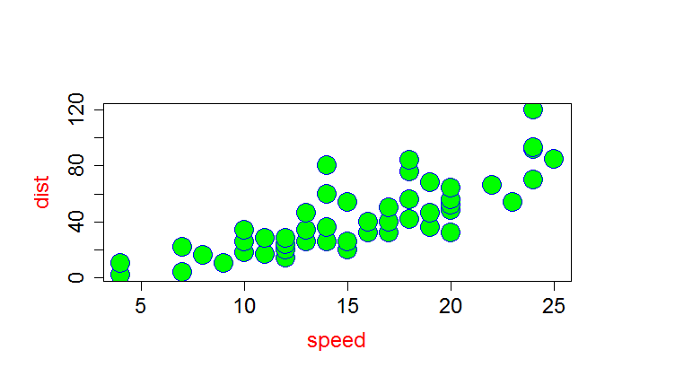
Setting Parameters cont…
In R | Explanation
Colors and Symbols
plot(cars,col.lab="red",cex=3, cex.axis=4,cex.lab=2, col="blue") colors() | “col” set plotting color “col.axis“ color for axis annotation “col.lab“ color for x and y labels “col.main“ color for titles “col.sub“ color for subtitles colors() returns all available colors Specify colors by index (col=1), name col=“white”, hexadecimal (col="#FFFFFF“), or RGB (col=rgb(0,0,0)).
?pch plot(cars,col.lab="red",cex=3, cex.axis=1.5,cex.lab=1.5, pch=21, col="blue", bg="green") | “pch” sets symbols “fg“ foreground color “bg“ background color

Slide 25
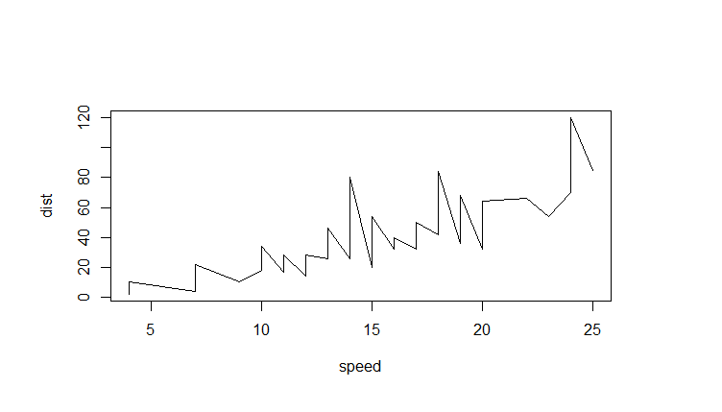

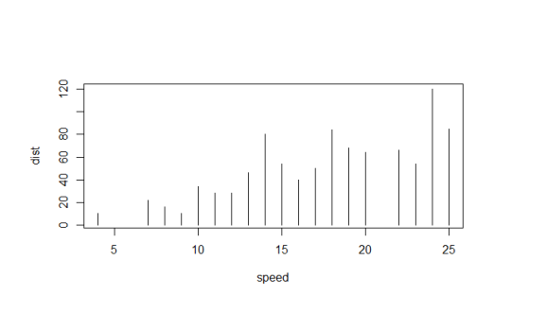
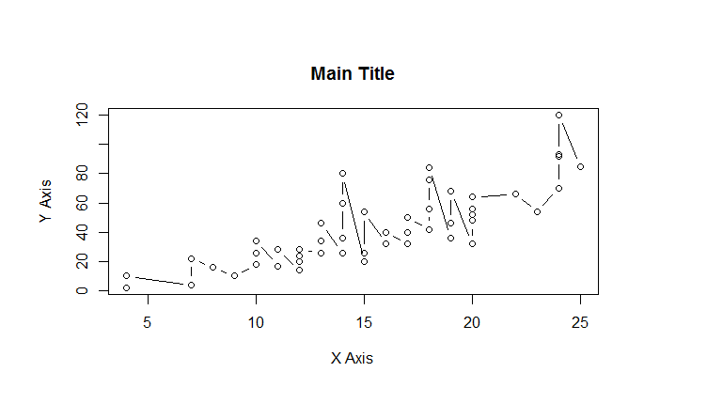
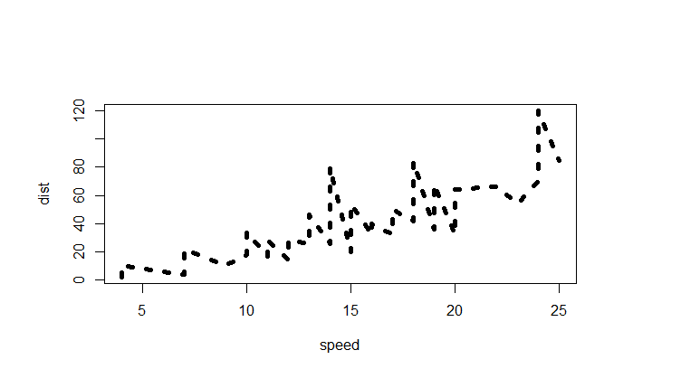
Setting Parameters cont…
In R | Explanation
Plot types, axis labels and line width
plot(cars, type="l") plot(cars, type="b") plot(cars, type="h") | Plot lines Plot lines and points Plot histogram
plot(cars, type="l", lty=3, lwd=5) | lty sets the line type; lwd sets the line width
plot(cars, type="b", main="Main Title", sub="Subtitle", xlab="X Axis", ylab="Y Axis") | Set labels of the x and y axis

Slide 26
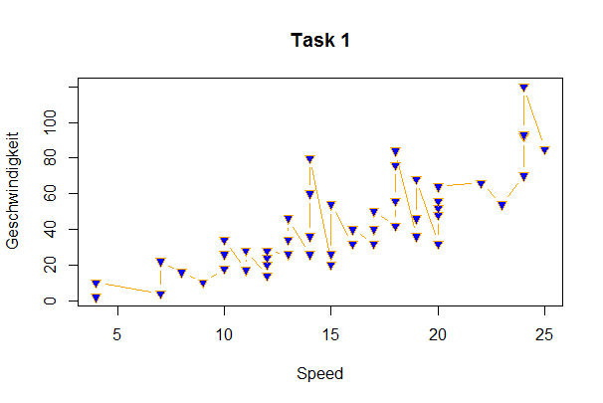
Task
Make a plot that looks like this:

Slide 27
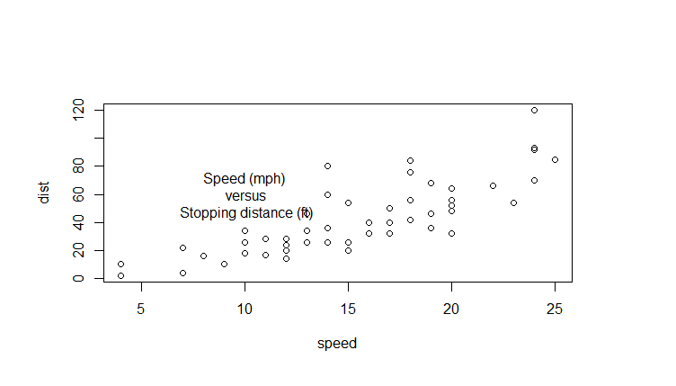
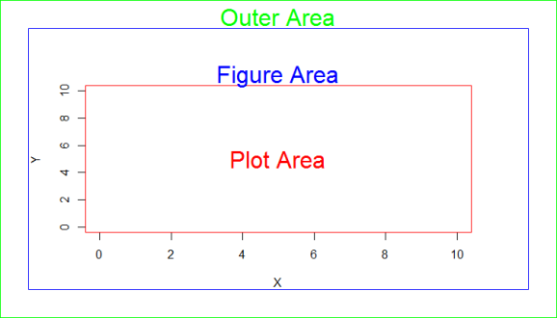
Setting Parameters cont…
In R | Explanation
Positions of elements within the plot and margins
plot(cars) text(10, 60, "Speed (mph)\n versus\n Stopping distance (ft)") | Add text to a plot with text(x-pos,y-pos,”text”)
plot(0:10, 0:10, type="n",xlab="X", ylab="Y") text(5,5,"Plot Area",col="red", cex=2) box(col="red") box(which="figure", col="blue") mtext("Figure Area", cex=2, col="blue") | Draw a plot with x and y axis from 0 to 10 Add text to the Plot Area box the plot area with the same colour Draw a box around the figure Add a text to the marginal area
par()$mar par(mar=c(4, 4, 4, 4)) par()$oma par(oma=c(2,2,2,2)) box(which="outer", col="green“, cex=1) mtext("Outer Area", cex=2, outer=TRUE, col="green") | Get the current margin settings Set margin sizes with mar Set outer margin size with oma Box outer area with green and add text to it

Slide 28
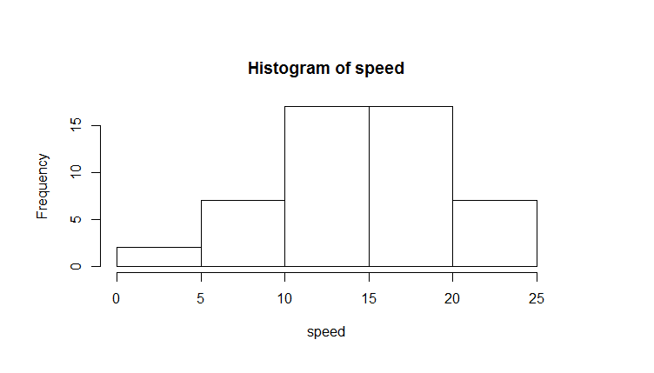
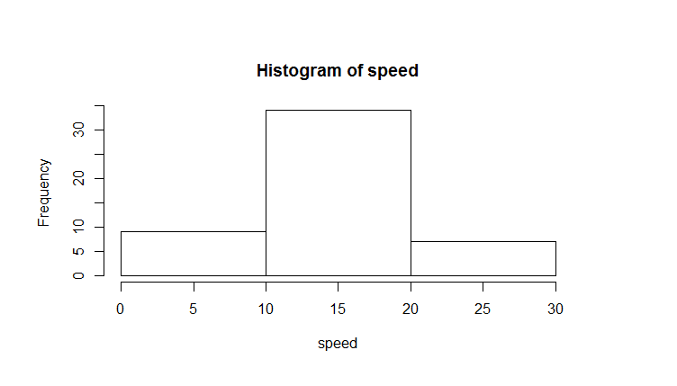
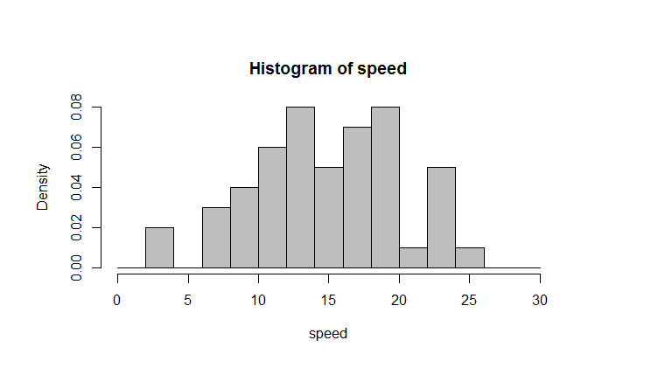
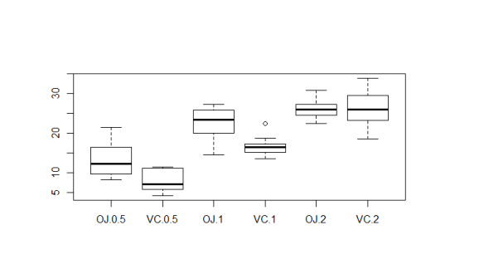
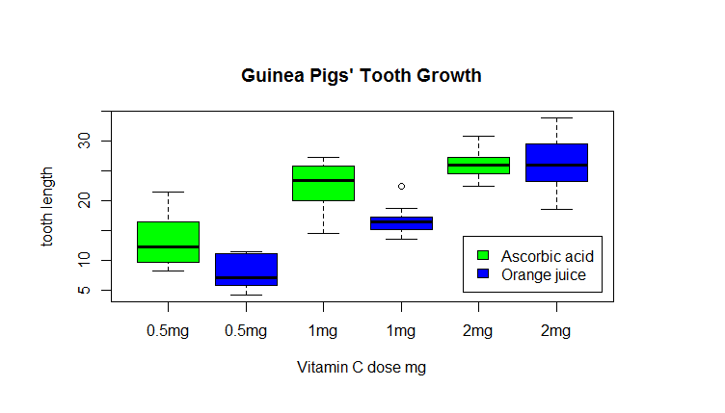
Different types of plots
In R |  | Explanation
Histograms
hist(cars$speed) hist(cars$speed, breaks=seq(from=0,to=30,10)) hist(cars$speed, breaks=seq(from=0,to=30,2), col="grey", freq=FALSE) | Hist plots a histogram Set breaks with by defining a sequence Switch from frequency to density histogram with freq=FALSE
Boxplots
boxplot(ToothGrowth$len~ToothGrowth$supp*ToothGrowth$dose) | Boxplot creates a boxplot with groups according to the supplement factor
boxplot(ToothGrowth$len~ToothGrowth$supp*ToothGrowth$dose, col=c("green", "blue"), main = "Guinea Pigs' Tooth Growth", xlab = "Vitamin C dose mg", ylab = "tooth length", xaxt="n") axis(1,at=seq(1:6),labels=c("0.5mg","0.5mg","1mg", "1mg","2mg","2mg")) legend(4.8, 14, c("Ascorbic acid", "Orange juice"), fill = c("green", "blue")) | Set different parameters of a boxplot Add a customized axis Add a legend

Slide 29
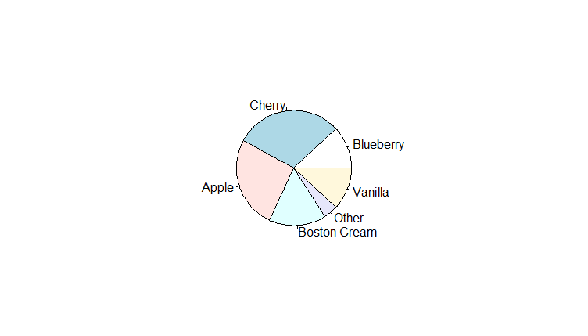
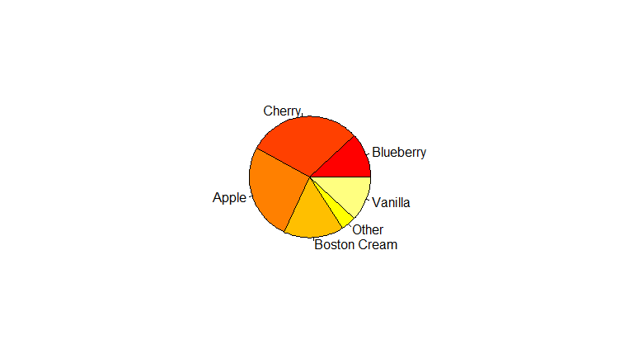
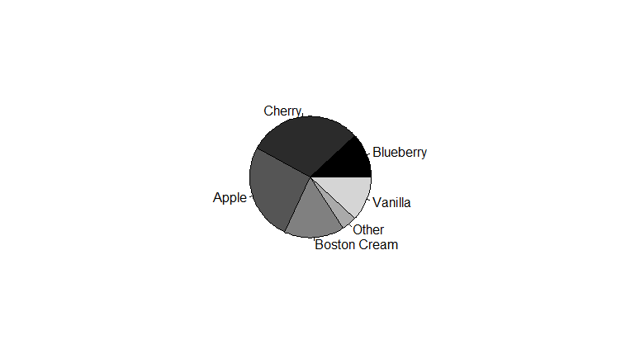
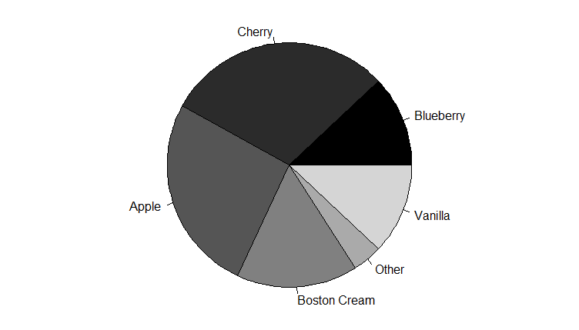
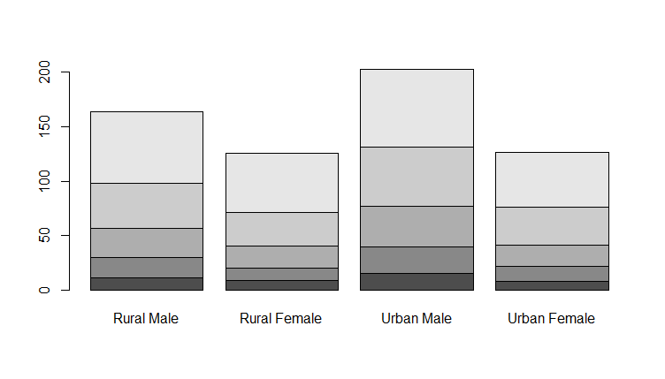
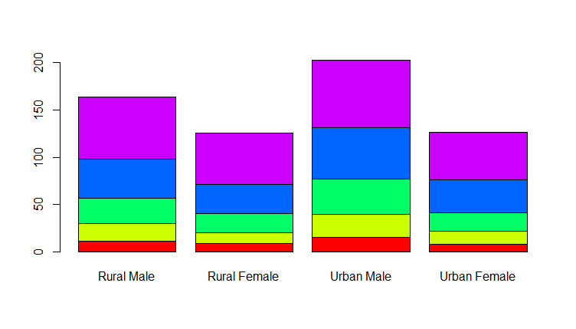
Other types of plots cont…
In R | Explanation
Pie Charts
sales <- c(0.12, 0.3, 0.26, 0.16, 0.04, 0.12) names(sales) <- c("Blueberry", "Cherry", "Apple", "Boston Cream", "Other", "Vanilla") pie(sales) | Create a vector with the data Define the “names” of the data Create a pie chart with the numbers from sales
pie(sales, col= heat.colors(6)) pie(sales, col = gray(0:6/6)) par(oma=c(0,0,0,0), mar=c(0,0,0,0)) pie(sales, col=gray(0:6/6)) | create color vectors with function rainbow(n), heat.colors(n), terrain.colors(n), topo.colors(n), and cm.colors(n). create color vectors with function gray
Barplots
barplot(VADeaths) barplot(VADeaths, col=gray(seq(0.3,0.7,0.1))) barplot(VADeaths, col=rainbow(5)) | Create barplots

Slide 30
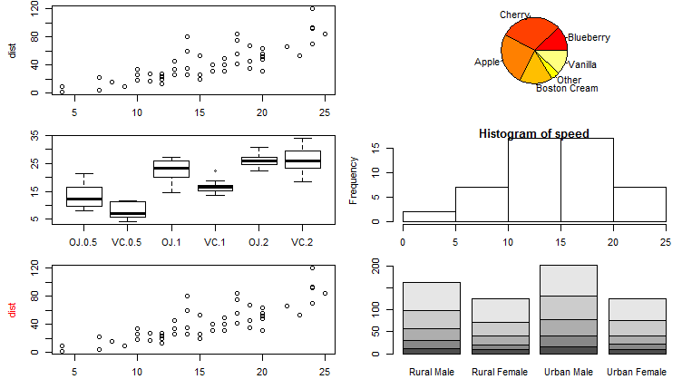
Multiple Plots on one page
In R | Explanation
par(mfrow=c(3,2),mar=c(3,4.5,0.5,0.5), oma=c(0,0,0,0)) plot(cars) pie(sales, col= heat.colors(6)) boxplot(ToothGrowth$len~ToothGrowth$supp*ToothGrowth$dose) hist(speed) plot(cars, col.lab="red") barplot(VADeaths) | Set the number of columns and rows with mfrow and plot the different plots in the order to display.

Slide 31
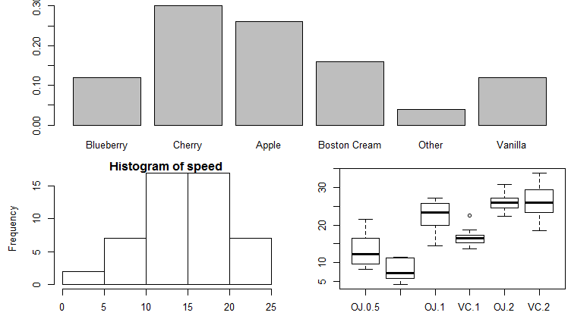
Multiple Plots on one page cont…
In R | Explanation
layout(matrix(c(1,1,2,3), 2, 2, byrow = TRUE)) layout.show(3) barplot(sales) hist(speed) boxplot(ToothGrowth$len~ToothGrowth$supp*ToothGrowth$dose) | layout(mat) with mat as a matrix object specifying the location of the figures to plot. Plot one figure in row 1 and two figures in row 2

Slide 32
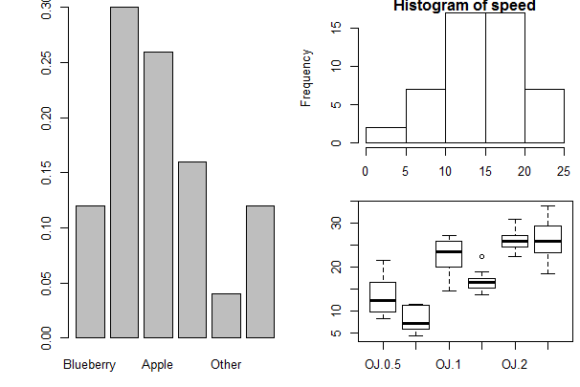
TASK
Make a plot that looks like this

Slide 33
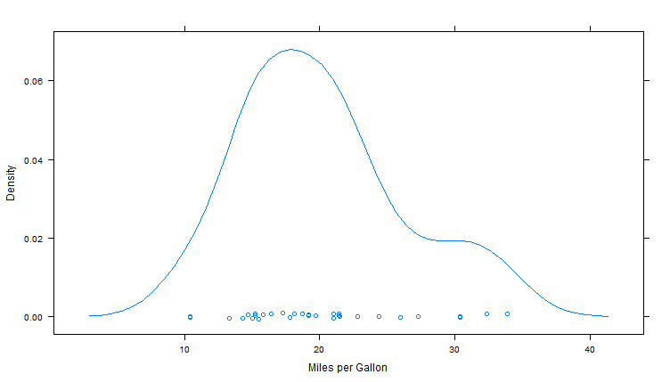
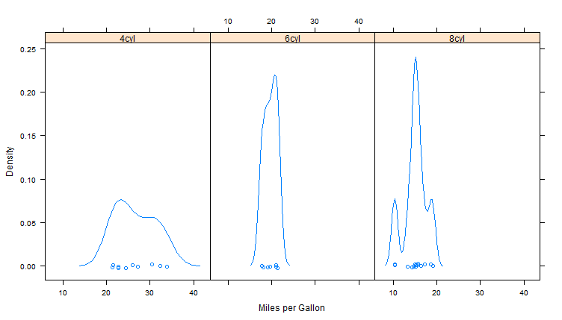
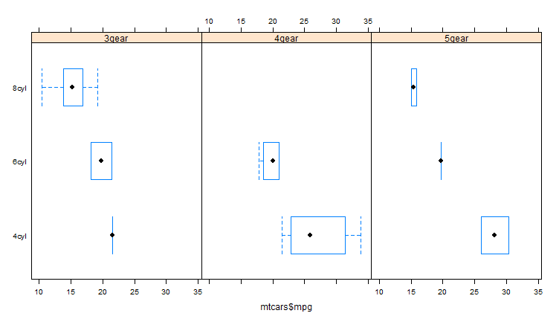
The Lattice Package
In R | Explanation
densityplot(mtcars$mpg, xlab="Miles per Gallon") | Create a kernel density plot
fact_cyl<-factor(mtcars$cyl, levels=c(4,6,8), labels=c("4cyl","6cyl","8cyl")) densityplot(~mtcars$mpg|fact_cyl, xlab="Miles per Gallon") | Kernel Density Plot by Factor Level typical formula in lattice is "graph_type(formula, data=)" ~x|A means display variable x for each level of factor A. y~x | A*B means display the relationship between numeric variables y and x separately for every combination of factor A and B levels. ~x means display numeric variable x alone.
fact_gear<-factor(mtcars$gear, levels=c(3,4,5), labels=c("3gear","4gear","5gear")) bwplot(fact_cyl~mtcars$mpg|fact_gear) | Boxplots by each combination of two factors

Slide 34
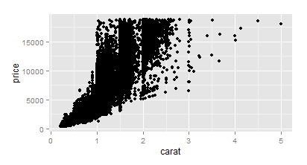
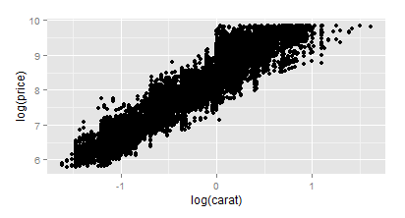
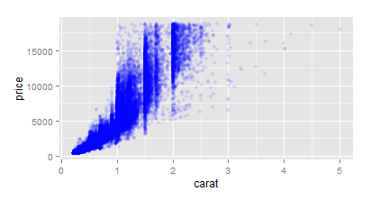
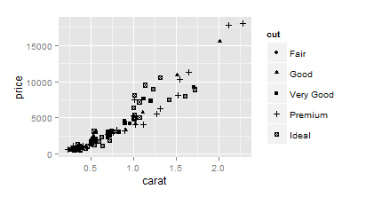
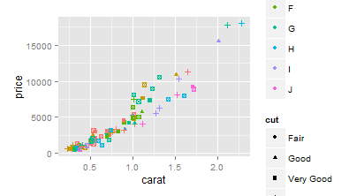
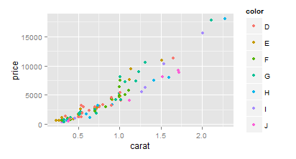
The ggplot2 package
In R | Explanation
qplot(carat, price, data = diamonds) | qplot can be used to create the most comon plot types e.g. scatterplots (default)
qplot(log(carat), log(price), data = diamonds, alpha=0.2) | qplot accepts formula arguments such as log
qplot(carat, price, data = diamonds, alpha=I(0.1), colour=I("blue")) | Set parameters manually with I()
dsmall <- diamonds[sample(nrow(diamonds), 100), ] qplot(carat, price, data = dsmall, colour = color) qplot(carat, price, data = dsmall, shape = cut) | Create a sample Plot with different colours for color Plot with different shapes for cut

Slide 35
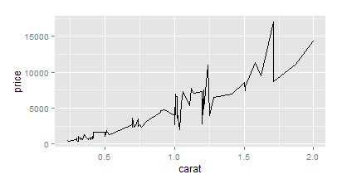
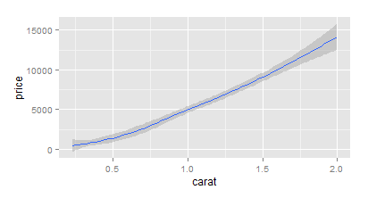
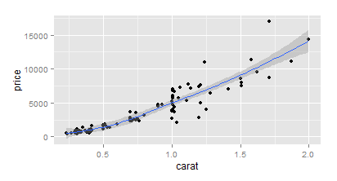
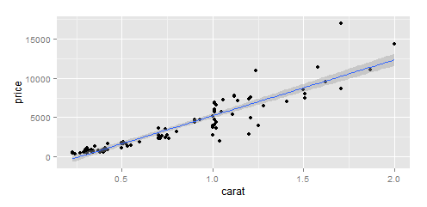
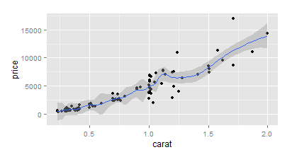
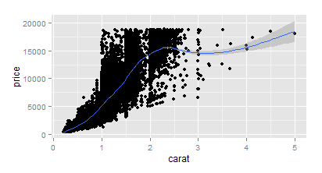
The ggplot2 package
In R | Explanation
qplot(carat,price,data=dsmall, geom="line") qplot(carat,price,data=dsmall, geom="smooth") qplot(carat,price,data=dsmall, geom=c("point","smooth")) | With “geom” different types of plots can be defined e.g. points, line, boxplot, path, smooth. These can also be combined in a vector.
qplot(carat,price,data=dsmall,geom=c("point","smooth")) qplot(carat,price,data=diamonds,geom=c("point","smooth")) | Depending on your dataset size the smooth function will select different methods that can be changed through method.
qplot(carat,price,data=dsmall, geom=c("point","smooth"), span=0.2) | With span the wiggliness of the line is controlled.
qplot(carat,price,data=dsmall,geom=c("point","smooth"),method="lm") | Use method to specify your smoothing method

Slide 36
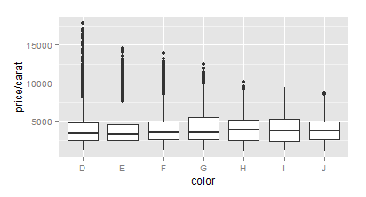
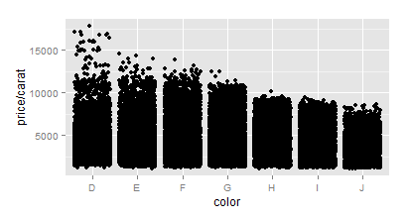
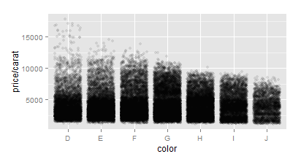
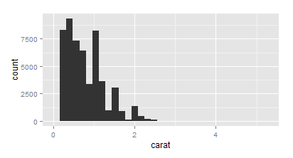
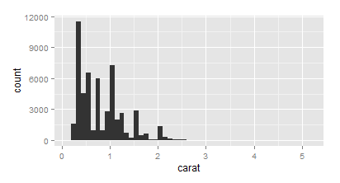
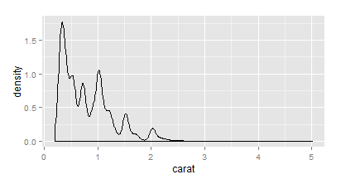



The ggplot2 package
In R | Explanation
qplot(color,price/carat,data=diamonds, geom="boxplot") qplot(color,price/carat,data=diamonds, geom="jitter") qplot(color,price/carat,data=diamonds, geom="jitter", alpha=I(0.1)) | Boxplots can be displayed through geom=“boxplot”. Jittered plots (geom=“jitter”) show all points. In case of overplotting changing alpha can help.
qplot(carat, data = diamonds, geom = "density") qplot(carat, data = diamonds, geom = "density", colour = color) qplot(carat, data = diamonds, geom = "density", fill = color, alpha=I(0.3)) | Histograms can be displayed through geom=“histogram”.
qplot(carat, data = diamonds, geom = "density") qplot(carat, data = diamonds, geom = "density",colour = color) qplot(carat, data = diamonds, geom = "density", fill = color, alpha=I(0.3)) | Density plots can be displayed through geom=“density”,

Slide 37


The ggplot2 package
In R | Explanation
qplot(displ, hwy, data = mpg, colour = cyl, geom=c("point","smooth"),method="lm") qplot(displ, hwy, data = mpg, colour = factor(cyl), geom=c("point","smooth"),method="lm") | Use factor to subset your data

Slide 38
Task
Be creative: Play around with ggplot 2

